Slide 1


Secure Overlay Cloud Storage with Access Control and Assured Deletion
Y. Tang, P.P.C. Lee, J.C.S. Lui, and R. Perlman
IEEE TRANSACTIONS ON DEPENDABLE AND SECURE COMPUTING, VOL. 9, NO. 6, NOVEMBER/DECEMBER 2012
COE-509 Presentation– Term 122
Farrukh Shahzad
May 2013
Information and Computer Science Department

Slide 2
Outline
Introduction
Related Work
FADE
Implementation & Evaluation
Conclusion

Slide 3
Introduction
Cloud Storage Model
New business solution for remote backup outsourcing
Reduces data management costs
APIs, web based user interfaces, and cloud storage gateways.
Cloud Storage Providers for individuals
iCloud
Dropbox
Google Drive
Amazon S3

Slide 4
Introduction
Advantages of Cloud Storage
fault tolerance
immediate access
Streaming
Problems
Access control
Assured deletion?
multiple copies for fault tolerance

Slide 5
Related Work
Blinded RSA[8] : Allows to get message signed by another party, without revealing message.
Shamir’s Secret Sharing[9]: Divide secret into n values, must know k or more values to get secret, also called (k, n) threshold scheme.
Time Based File Deletion[4]: files remain permanently inaccessible after a predefined duration.
Attribute Based Encryption[5,6]: Cipher text-Policy Attribute-Based Encryption (CP-ABE)

Slide 6
RSA & Blinded RSA
RSA public key (e, n) encryption - C = m^{e} mod n private key (d, n) decryption - m = C^{d} mod n | Blinded RSA Choose r such that gcd(r,n)=1 Send x = (m . r^{e}) mod n Receive y = x^{d} mod n Get m^{e} mod n = (r⁻¹ . y) mod n

Slide 7
Fade Overview
FADE clients. A FADE client
(or client for short) is an interface that
bridges the data source (e.g., filesystem)
and the cloud. It applies encryption
(decryption) to the outsourced data
files uploaded to (downloaded from) the
cloud. It also interacts with the key
Managers to perform the necessary
cryptographic key operations.
Key managers. FADE is built on a quorum of key managers, each of which is a stand-alone entity that maintains policy-based keys for access control and assured deletion.

Slide 8
Security Goals
Threat Model:
  Active files: Oscar should not be able to access the file.
  Deleted files: if the files are actually deleted by the provider if requested.
Avoid unauthorized access
  policy-based access control
Unrecoverable deleted files
  policy based assured deletion

Slide 9
Policies
Rules to allow file access
  P: Alice is an employee.
Conjunctive policies
  P1: Bob is an employee.
  P2: Valid before some date.
  P1 ^ P2
Disjunctive policies
  P1: Bob is a member of team x.
  P2: Alice is a member of team x.
  P1 V P2

Slide 10
Keys
Data key
  A data key is a random secret that is generated and maintained by a FADE client.
  It is used for encrypting or decrypting data files via symmetric key encryption (e.g., AES).
Control key
  A control key is associated with a particular policy. It is represented by a public-private key pair, and the private control key is maintained by the quorum of key managers.
  It is used to encrypt/decrypt the data keys of the files protected with the same policy.
  The control key forms the basis of policy-based assured deletion.
Access key
  Similar to control key, an access key is associated with a policy, and is represented by a public-private key pair.
  However, the private access key is maintained by a FADE client that is authorized to access files with associated policy.
  The access key is built on attribute-based encryption [5], and forms the basis of policy-based access control.

Slide 11
Notation used

Slide 12
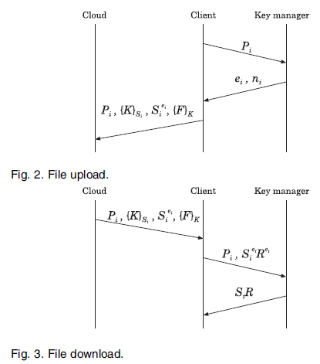
Basic Operation of FADE
File Upload
  Ask public key for policy P_{i} (n_{i} , e_{i})
  Generate S_{i}, K
  Encrypt data file F with K
  Encrypt K with S_{i}
File Download
  Get metadata and encrypted file.
  Generate R for blinded RSA
  Send policy with blinded RSA secret key
  Get S_{i}R to decrypt {K}_{Si} and hence {F}_{K}

Slide 13
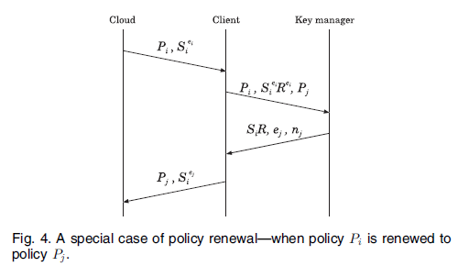
Policy Renewal
Policy renewal merely operates on keys, without retrieving the encrypted file from the cloud.
Special Case:
  Get metadata of file
  Decrypt to get data key
  Encrypt data key with new keys/policies

Slide 14
Extension to FADE
Attribute Based Encryption & threshold secret sharing
Access key is added to make fade scalable and internally secure.
client presents credentials to key manager
key pair for a policy (ei, di)
  client keep the private key
key manager encrypts with access key
only authorized clients can decrypt.
Multiple key managers are used for reliability.

Slide 15
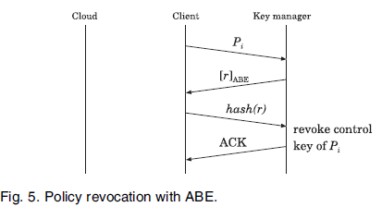
Operation of Extended FADE
File Upload
  No Change
File Download
  key manager sends (SR) encrypted(ABE) with access key.
Policy Renewal
  key manager sends (SR) encrypted (ABE) with access key.
Policy Revocation
  To revoke Policy P_{i}. Just need to communicate with key manager.

Slide 16
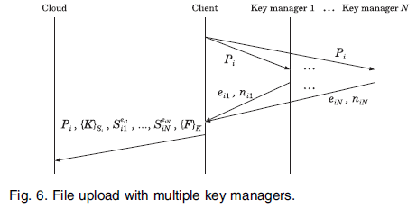
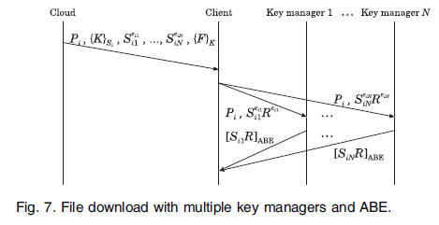
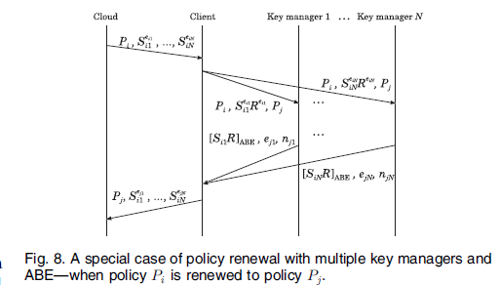
Multiple Key managers

Slide 17
Implementation
Amazon S3 as cloud storage
C++ on Linux
  LibAWS++ for Amazon interfacing
OpenSSL for cryptography (1024-bit RSA, AES)
cpabe for ABE based access control
ssss for key sharing among managers

Slide 18
Evaluation
Performance criteria
  File transmission time
  Metadata transmission time
  Cryptographic operation time

Slide 19
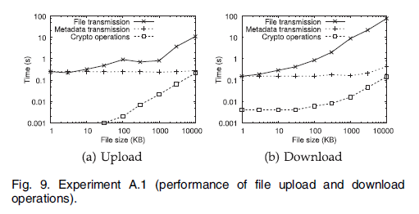
Evaluation (without ABE)

Slide 20
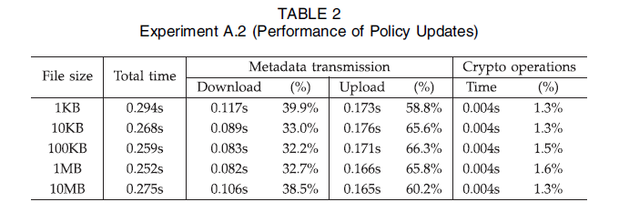
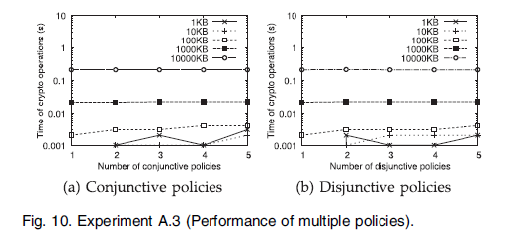
Evaluation (without ABE)

Slide 21
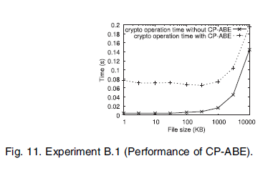
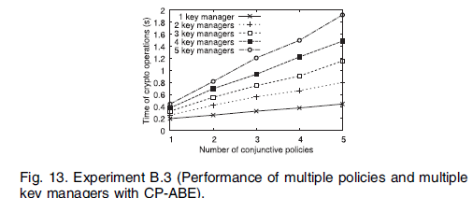
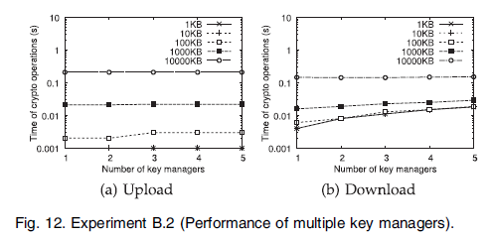
Evaluation (Extended with ABE)

Slide 22
Conclusion
FADE
  Policy based file assured deletion.
  Attribute based access control.
  No change at cloud storage end.

Slide 23
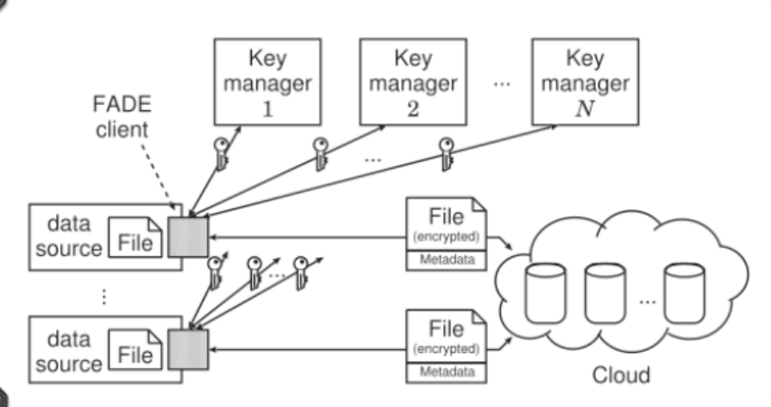
System Overview
23

Slide 24
References
24
Y. Tang, P.P.C. Lee, J.C.S. Lui, and R. Perlman,, Secure Overlay Cloud Storage with Access Control and Assured Deletion, IEEE TRANSACTIONS ON DEPENDABLE AND SECURE COMPUTING, VOL. 9, NO. 6, NOVEMBER/DECEMBER 2012.
Amazon S3, http://aws.amazon.com/s3, 2010
http://blog.fileburst.com/personal-cloud-storage-explained/
R. Geambasu, T. Kohno, A. Levy, and H.M. Levy, “Vanish: Increasing Data Privacy with Self-Destructing Data,” Proc. 18th Conf. USENIX Security Symp, Aug. 2009.
V. Goyal, O. Pandey, A. Sahai, and B. Waters, “Attribute-Based Encryption for Fine-Grained Access Control of Encrypted Data,” Proc. 13th ACM Conf. Computer and Comm. Security (CCS), 2006.
J. Bethencourt, A. Sahai, and B. Waters, “Ciphertext-Policy Attribute-Based Encryption,” Proc. IEEE Symp. Security and Privacy, May 2006.
R. Perlman, “File System Design with Assured Delete,” Proc. Network and Distributed System Security Symp. ISOC (NDSS), 2007.
http://www.rsa.com/rsalabs/node.asp?id=2339
http://www.cs.tau.ac.il/~bchor/Shamir.html
http://ansrlab.cse.cuhk.edu.hk/software/fade
Dropbox, http://www.dropbox.com, 2010.

